Slide 1
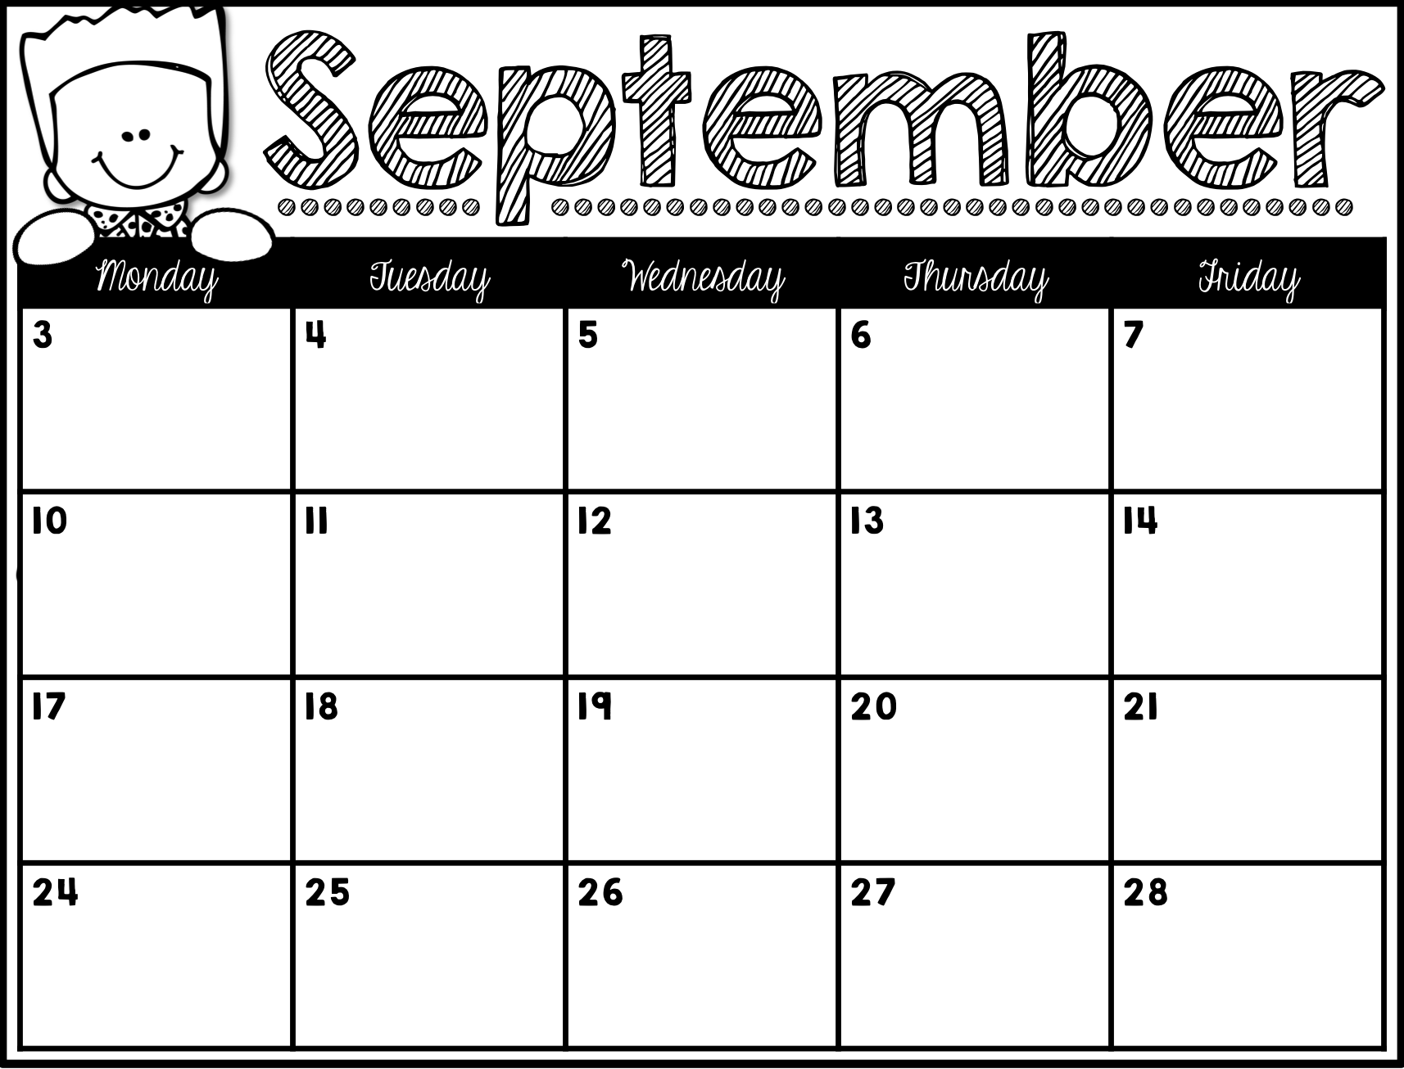
Snacks From:
Dayanna
Snacks From:
Julian A.
Snacks From:
Giuliana
Snacks From:
Leena
No School
Snacks From:
Santiago
Snacks From:
Annahy
Snacks From:
Teagan
Snacks From:
Brendon
Snacks From:
Julian C.
Snacks From:
Mya
Snacks From:
Adrianna
Snacks From:
Hailey
Snacks From:
Hana
Snacks From:
Mia
Snacks From:
Azijah
Snacks From:
A’Mahnee
Snacks From:
Leonardo
Snacks From:
Xzylah
Snacks From:
Kashmaree

